Slide 1
FIG TREATMENT ON BREAST CANCER
Tunahan DÜNDAR 140101009
Notes:
My topic is an alternative way to treatment of cancer.
alternative because that is not an medical drug or it is even not a medical plant

Slide 2
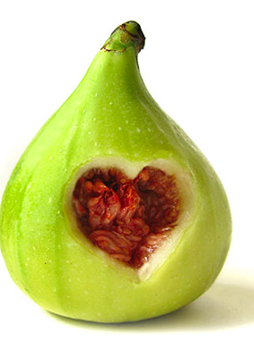
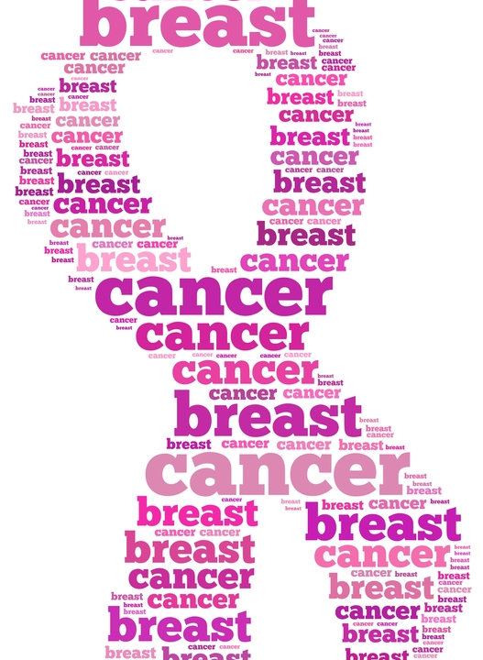
Investigation of Ficus Carica Plantae’ Cytotoxic, Genotoxic, Apoptotic, Antineoplastic, Anti inflammatory and Autophagic Effects on Breast Cancer Cells
Notes:
We purpose with this Project to find out fig can be a treatment on cancer cells.
and if want to see antiicancerogic effect ,

Slide 3
Why CANCER ???
Second death reason after the cardiovascular diseases
Long term treatment
Treatment process is diffucult
Too many irritable side effect of cancer treatment .
Advanced research and application center of traditional and complementary medicine
Notes:
Death is a reality. Most common death reason is cardiovascular disease in the World. Cancer is following it by second one.
Cancer treatment process is too long and hard to continous. Because of this reason scientist look for traditional and complementary medicine.

Slide 4
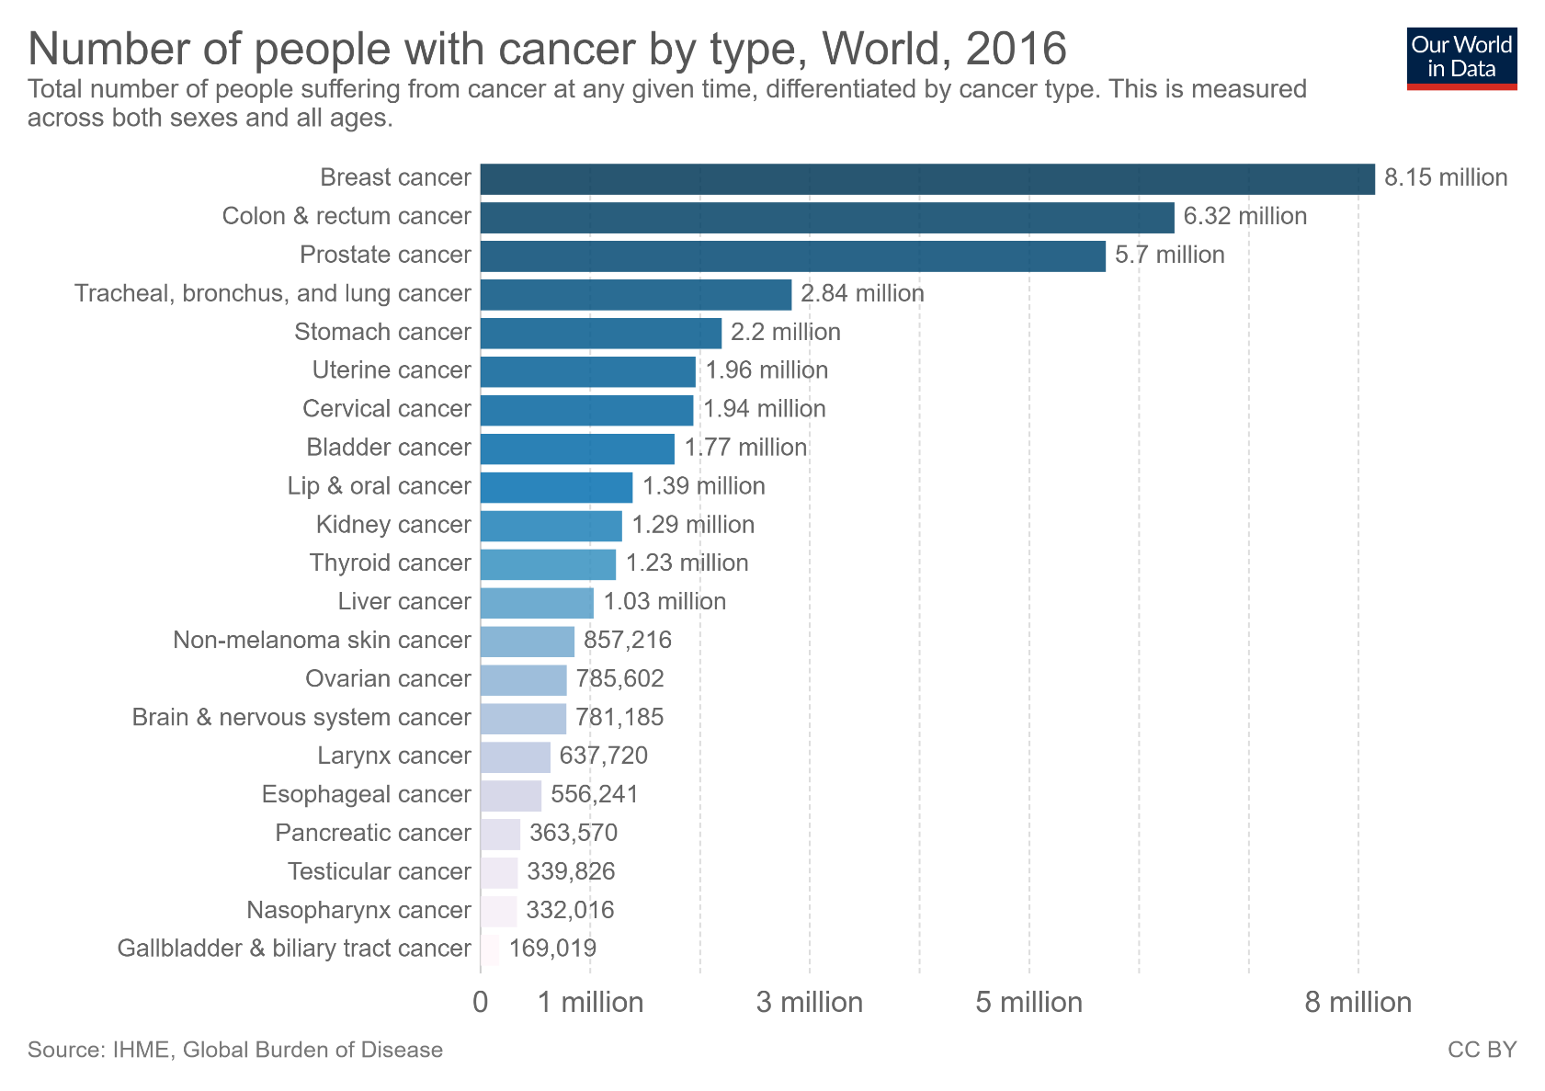
Breast CANCER !!!
Most common cancer.
Notes:
When broken down by cancer type we see that globally breast cancer is the most prevalent form, followed by colon & rectum, and prostate cancer.
Across most countries these are the top three cancer forms, however they tend to vary in their ranking across the World.
Breast cancer is almost fifth one among death which depend cancer in the world.

Slide 5
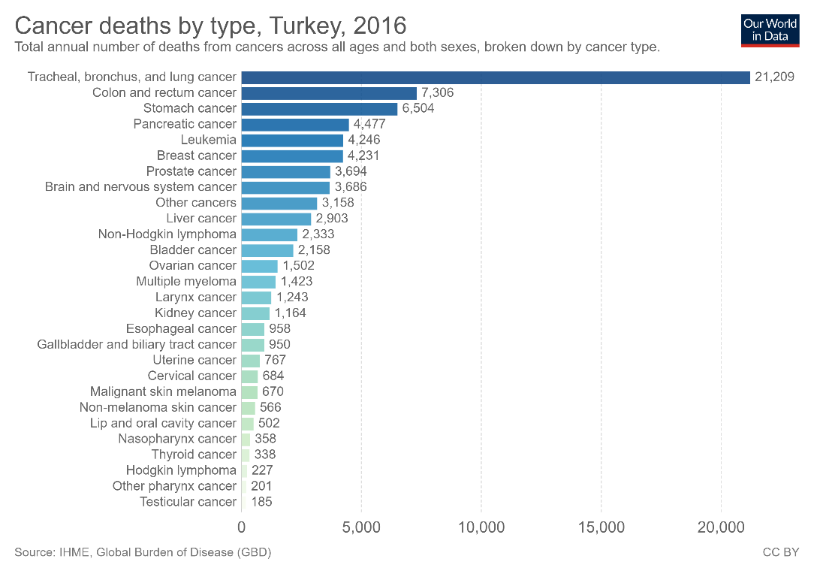
DEATH RATES ☹☹☹
6
5
Rates of death which depend on cancer.
Notes:
Breast cancer is almost fifth one among death which depend cancer in the world.
in turkey this station is one step behind the World 6. reason of death depend on cancer.

Slide 6
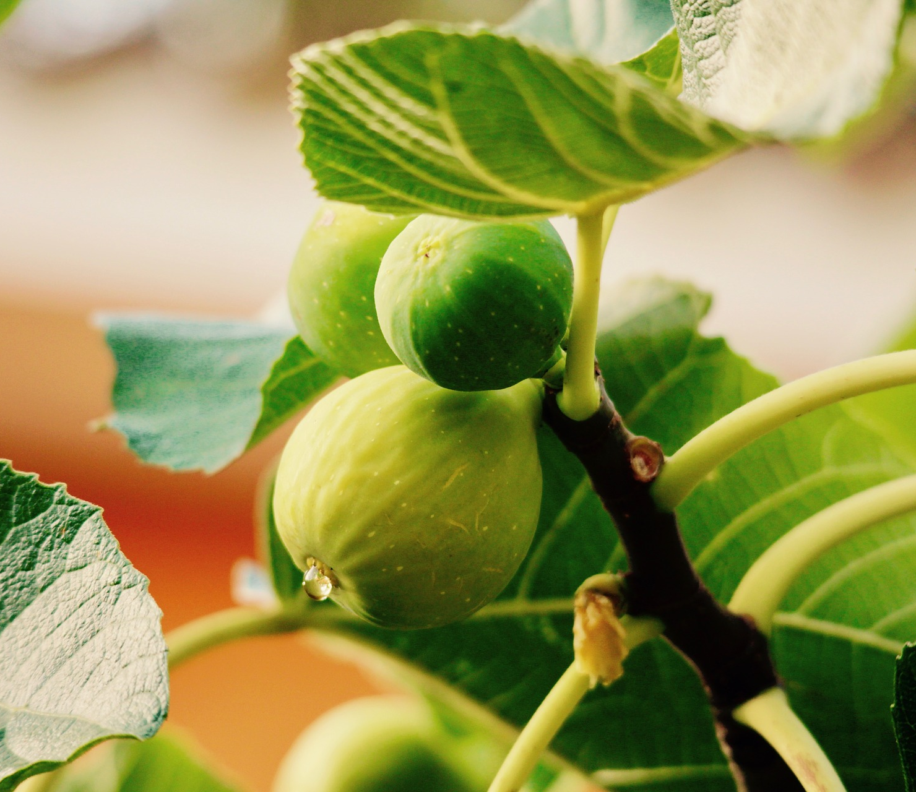
FIG (Ficus Carica)
Meditarranean fruit and also Turkey is the World leader in terms of fig production.
Ficus carica’s family is Moracae.
Easy to find out and delicious fruit.
Notes:
Ficus carica also have antioksidant , antimicrobial and anti cancerogenic effect on the other cancer cell lines.
But scientific studies are limited on breast cancer. we purpose with this study to Show antineoplastic effect of ficus carica on the breast cancer.

Slide 7
FIG (Ficus Carica)-2
Figs are an excellent source of phenolic compounds such as proanthocyanidins
High amounts of fiber and polyphenols.
Notes:
Its fruit, root and leaves are used in traditional medicine to treat various ailments such as gastrointestinal (colic, indigestion, anorexia and diarrhea), respiratory (sore throat, cough and bronchial problems) and cardiovascular diseases, as well as an inflammatory and antispasmodic drug.
F. Carica fruits have been reported to be an important source of vitamins, minerals, carbohydrates, organic acids and phenolic compounds. Fresh and dried figs also contain high amounts of fiber and polyphenols.

Slide 8
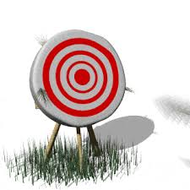
GOAL
To investigate the cytotoxic, genotoxic and apoptotic effects of Ficus carica extracts prepared in different organic solvents on breast cancer.
Notes:
Ficus carica ’nin farklı organik çözücülerde hazırlanan ekstrelerinin meme kanseri üzerindeki sitotoksik, genotoksik ve apoptotik etkisini araştırmak

Slide 9
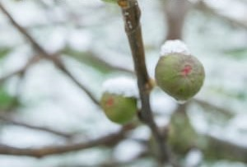
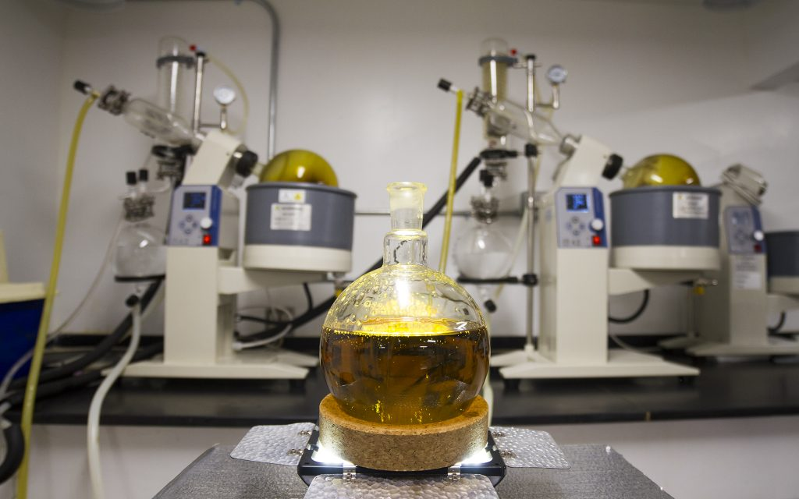
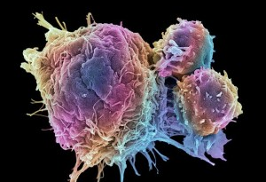
Material & Methods
Alcholic (metoh or etoh) and water extraction
Antioxidant capacity
Prooxidant capacity
Choose best extract
MCF-7 breast cancer cells
Investigate cytotoxicity (ATP), genotoxicity (DNA Damage), Apoptosis (AO/EB Dye), intracellular ROS
Notes:
Ficus carica fruit obtained from Aydın Directorate of provincial agriculture and forestry was extracted in different solvents.
The whole ficus materials protect at zero centigrade degrees
In the literature(lidirıçır) most common extraction method is ethanolic and water extraction. We used both and we’ll also compare their effect. and we find methanolic extraction is more effecive than other method.
adenocarcinoma epithelial MCF7
DNA hasarı komet assay ile also called single cell gel electrophoresis
apopitoz
apoptotic effect by acridine orange/ethidium bromide method.
tas SPEKTROMETREDE BAKILDI c vitamini baz alınarak
fenol flavnoid bakıldı bide kersetin baseline olarak alınarak.

Slide 10
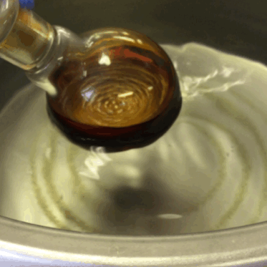
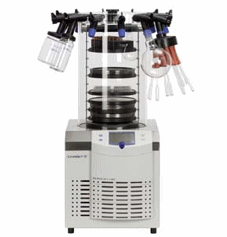
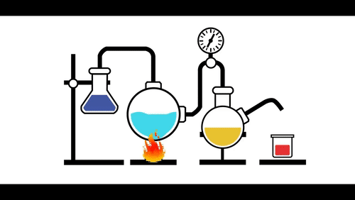
Material & Methods-2
2018 crop obtained from Aydın Provincial Directorate of Agriculture was extracted in methanol and ethanol solvents of F.carica.(500 mg/mL).
After 24 hours of incubation at room temperature, first the organic phase and then the water phase were removed with evaporator and lyophilizer.
Notes:
Aydın İl Tarım Müdürlüğü’nden temin edilen 2018 mahsulü F.carica’ nın metanol ve etanol çözücülerinde ekstrakte edildi (500 mg/mL).
24 saat oda sıcaklığı inkübasyonun ardından, evoparatör ve liyofilizatör ile önce organik faz daha sonra su fazı uzaklaştırıldı.

Slide 11
Material & Methods-3
Antioxidant Activity Determination Methods
Determination of Total Antioxidant Level – (photometric)
Determination of Prooxidant Capacity- (photometric)
Determination of Total Phenolic Content – (photometric)
Determination of Total Flavonoid Content– (photometric)
Measurement of copper (II) ion-reducing antioxidant capacity (CUPRAC)– (photometric)
Determination of DPPH (2,2-Diphenyl-1-picrylhydrazyl) free radical activity– (photometric)
Notes:
Total Antioksidan Seviyenin Belirlenmesi – (fotometrik)
Prooksidan Kapasitenin Belirlenmesi – (fotometrik)
Total Fenolik İçeriğin Belirlenmesi – (fotometrik)
Total Flavonoid İçeriğin Belirlenmesi– (fotometrik)
Bakır (II) iyonu indirgeyici antioksidan kapasitenin (CUPRAC) Ölçümü – (fotometrik)
DPPH (2,2-Difenil-1-pikrilhidrazil) serbest radikal aktivitesi tayini – (fotometrik)

Slide 12
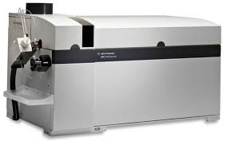
ICP-MS ile Ağır Metal Tayin
Material & Methods-4
In this study, the heavy metal contents of Cr, Mn, Co, Ni, Cu, As, Cd, Hg of the samples were examined and the concentrations of metals were determined by ICP-MS.
Notes:
Bu çalışmada numunelerin Cr, Mn, Co, Ni, Cu, As, Cd, Hg ağır metal içerikleri incelendi ve metallerin konsantrasyonları ICP-MS ile belirlendi.
inductively Coupled Plasma – Mass Spectrometer
katı ve sıvı örneklerde çok sayıda elementin hızlı, ucuz, hassas ve doğru biçimde, niteliksel, niceliksel ya da yarı-niceliksel olarak ölçülmesine olanak sağlayan ileri teknoloji ürünü bir analiz tekniğidir. Teknik elektromanyetik indüksiyonla 10,000 oK sıcaklığa ulaştırılan argon plazması tarafından örneğin iyonize edilmesi; iyonize elementlerin kütle spektrometresi tarafından ayrıştırılması ve element derişimlerinin elektron çoklayıcı bir dedektör tarafından ölçülmesi aşamalarını içerir. Örnekteki tüm elementlerin derişimleri 1 ile 2 dakika arasında değişen oldukça kısa bir sürede ölçülür

Slide 13
Biological Activity Experiments
Material & Methods--5
Methanol extract ..
Different concentrations of Ficus carica extract were applied on Breast cancer cell lines.
Viability Test - Intracellular ATP was measured luminometrically.
Intracellular Reactive Oxygen Species (ROS) level was measured fluorometrically using H2DCFDA fluorescence dye.
Intracellular Glutathione Level - measured by luminometric method.
Mitochondrial Membrane Potential - was measured fluorometrically using DiO3C6 dye.
Notes:
Metanol ekstresi.. Ficus carica ekstraktının farklı konsantrasyonları Meme kanseri hücre hatları üzerine uygulandı.Canlılık Testi – Hücre içi ATP’yi luminometrik olarak ölçüldü.Hücre içi Reaktif Oksijen Türleri (ROS) düzeyi – H₂DCFDA floresesans boyası kullanarak florometrik olarak ölçüldü.Hücre içi Glutatyon Düzeyi – luminometrik yöntemle ölçüldü.Mitokondriyal Membran Potansiyeli - DiO₃C₆ boyası kullanarak florometrik olarak ölçüldü.

Slide 14
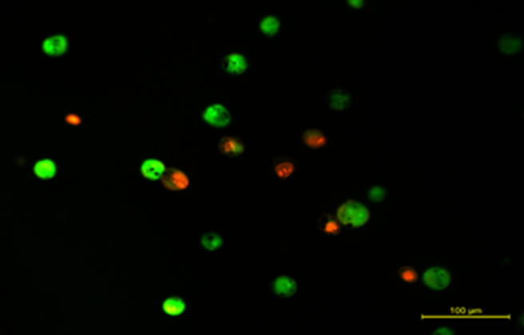
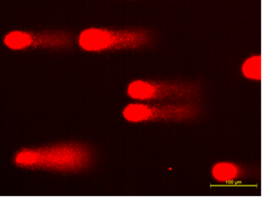
Material & Methods-6
In different studies to examine the apoptotic effect, breast cancer cells were tested in different tests, after 24 incubation, they were removed with trypsin-EDTA, treated with acridine orange / ethidium bromide dye and imaged under fluorescence microscopy.
Genotoxic damage was examined as DNA Damage using the comet assay method.
Şekil 1.Yeşil renkli hücreler canlı, turuncu renkli hücreler apoptotik hücreleri göstermektedir.
Şekil 2.Comet Assay görüntüleri (Kuyruk uzunlukları herbir hücrenin DNA hasar seviyesini göstermektedir).
Notes:
Apoptotik etkiyi incelemek için farklı konsantrasyonlarda Meme kanseri hücrelerine verilen Ficus carica’nın 24 saatlik inkübasyonundan sonra hücreler tripsin-EDTA ile kaldırılıp, akridin turuncusu/etidyum bromid boyası ile muamele edilip floresans mikroskobunda görüntülendi. Genotoksik hasar comet assay yöntemiyle DNA Hasarı olarak incelendi.

Slide 15
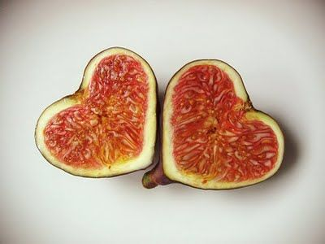
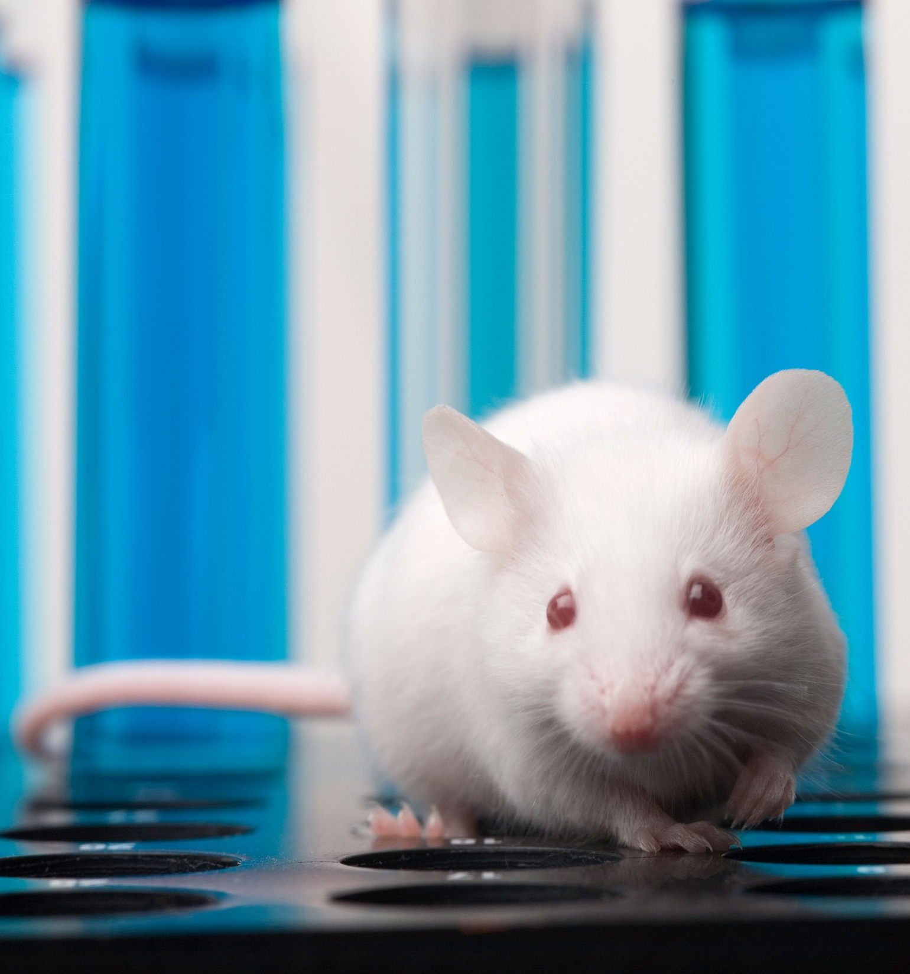
Result AND Discussion
Notes:
Among solvents, the highest antioxidant and prooxidant activity was found to be in methanol extract. In addition, Ficus carica has been shown to have cytotoxic, genotoxic and apoptotic effects on breast cancer in dose dependent manner.It can be novel phytotherapeutic agents for cancer treatment.
If I can get accept from Scientific Research Project Support Fund we want to make same Project on laboratory animals.

Slide 16
In Vitro Antioxidant Activity Results
It was observed that the methanol extract of Ficus carica L. had a higher phenolic and flavonoid content than the ethanol extract and the total antioxidant capacity increased as the dose increased.
+++
***
+++
***
***
***
***
***
***
+++
***
***
***
+++
***
Notes:
Ficus carica L.’nin metanol ekstresinin etanol ekstresine göre daha yüksek fenolik ve flavanoid içeriğinin olduğu ve doz arttıkça da total antioksidan kapasitenin arttığı görülmüştür.

Slide 17
Results-2
+++
***
+++
***
+++
+++
***
***
Radical scavenging activity and copper reduction activity were also found to be strong.
Notes:
Radikal süpürücü aktivite ve bakır indirgenme aktivitesinin de güçlü olduğu tespit edildi.

Slide 18
In the methanol and ethanol extract of figs, a certain dose of antioxidant showed a pro-oxidant effect after a certain dose. Doses after this critical dose will be the doses to be determined for cancer treatment.
Result-3
Notes:
İncirin metanol ve etanol ekstresinde belli bir doza antioksidan belli bir dozdan sonra prooksidan etki göstermiştir. Bu kritik dozdan sonraki dozlar kanser tedavisi için belirlenecek dozlar olacaktır.

Slide 19
Biological Activity Results
Result-4
It was observed that it increased up to a certain dose in the cell and then decreased as the dose increased.
When the cytotoxicity results were examined, ROS level decreased in cancer cells at low doses, while the amount of ROS increased with increasing dose.
Since the metabolic activity of the cancer cell is high, the increased ROS originating from the fruit extract showed a synergistic effect and killed the cells.
*
*
**
**
**
***
***
***
**
***
***
*
*
**
Notes:
ATP canlılık seviyesinin
hücrede belli bir doza kadar artıp sonrasında doz arttıkça azaldığı görülmüştür.
Sitotoksisite sonuçları incelendiğinde düşük dozlarda kanser hücresinde ROS düzeyi düşerken doz arttıkça ROS miktarı artmıştır.
Zaten kanser hücresinin metabolik aktivitesi yüksek olduğundan bir de meyve ekstresi kaynaklı artan ROS sinerjik etki gösterip hücreleri öldürmüştür. ​

Slide 20
Result-5
*
**
***
**
**
***
***
It was observed that the intracellular glutathione level and mitochondrial membrane potential decreased with increasing doses of Ficus carica.
This caused the cells to be led to apoptosis.

Slide 21
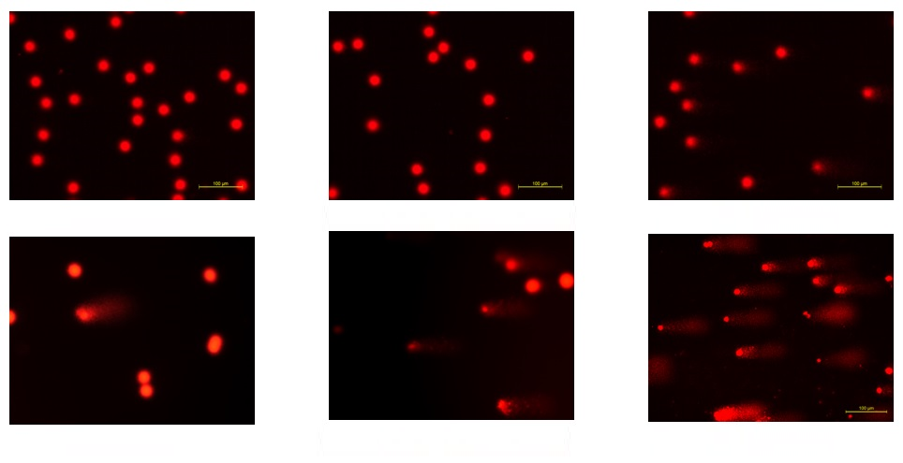
Results-6
***
***
***
**
Increased DNA damage was observed with increasing doses of Ficus carica.
*
Kontrol
20 mg/mL
40 mg/mL
60 mg/mL
80 mg/mL
100 mg/mL
Notes:
Artan Ficus carica dozlarında DNA hasarının arttığı görülmüştür.

Slide 22
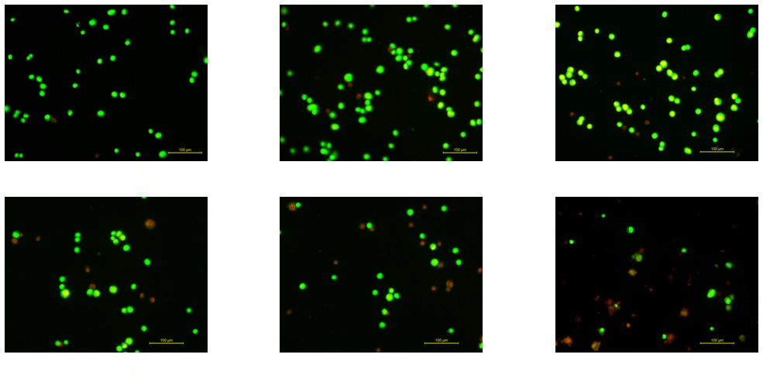
Results-7
***
***
***
**
*
When apoptosis, one of the cell death mechanisms, was examined, it was seen that increasing Ficus carica doses led breast cancer cells to more apoptosis.
Kontrol
20 mg/mL
40 mg/mL
60 mg/mL
80 mg/mL
100 mg/mL
Notes:
Hücre ölüm mekanizmalarından apoptoz incelendiğinde, artan Ficus carica dozlarının Meme kanser hücrelerini daha çok apoptoza götürdüğü görülmüştür.

Slide 23
Discussion-1
When the antioxidant profiles of methanol and ethanol extracts of Ficus carica were examined, it was found that methanol extract had more antioxidative effects.
Heavy metal analysis of the methanol extract was performed by ICP-MS and it did not cause toxicity since the mentioned metals were not extracted at high levels.
In the evaluation of biological activity, methanol extract on breast cancer,
With the increasing dose; increases cytotoxicity,
Increases intracellular ROS levels,
Increases DNA Damage,
It increases apoptosis,
It decreases intracellular glutathione levels,
It was found to reduce mitochondrial membrane potential.
Notes:
Ficus carica’nın metanol ve etanol ekstrelerinin antioksidan profillerine bakıldığında metanol ekstresinin daha fazla antioksidatif etki gösterdiği bulunmuştur.
Metanol ekstresinin ağır metal analizi ICP-MS ile yapılmış ve belirtilen metaller yüksek düzeyde çıkmadığından dolayı toksisite yaratmamıştır.
Biyolojik aktivite değerlendirilmesinde metanol ekstresinin Meme kanseri üzerinde,
Artan dozla; sitotoksisiteyi arttırdığı,
Hücreiçi ROS düzeylerinin arttırdığı,
DNA Hasarını arttırdığı,
Apoptozu arttırdığı,
Hücre içi glutatyon düzeylerini düşürdüğü,
Mitokondriyal membran potansiyelini düşürdüğü bulundu.

Slide 24
Discussion-2
As a result of these results, Ficus carica, which has anti-cancer properties
It is thought that it can be used in combination with routine treatments in breast cancer treatment.
Therefore, our next study will be combined therapy with agents used in routine therapy and later animal studies.
Notes:
Bu sonuçlar neticesinde anti-kanser özelliği bulunan Ficus carica
Meme kanseri tedavisinde rutin tedavilerin yanında kombine olarak kullanabileceği düşünülmektedir.
Bu yüzden bir sonraki çalışmamız rutin tedavide kullanılan ajanlarla kombine tedavi ve daha sonra hayvan çalışmaları olacaktır.

Slide 25
References:
Özenoğlu, S., Aydoğdu, G., Dinçsoy, A.B., Taghizidaj, A.A., Derici, K., Yılmaz, E., Aras, S., C.Duman, D., 2013. Liken Sekonder Bileşiklerinin farklı insan kanser hücre tipleri üzerine antikanserojenik etkisi. Türk Hijyen ve Deneysel Biyoloji Dergisi, 70(4): 215-226.
Lin Jing, Yang-Mei Zhang, Jian-Guan Luo, and Ling-Yi Kong., 2015. Tirucallane-type triterpenoids from the fruit of Ficus carica and their cytotoxic activity Chemical and Pharmaceutical Bulletin, 2015;63(3):237-43.
Rubnov S, Kashman Y, Rabinowitz R, Schlesinger M, Mechoulam R., 2001. Suppressors of cancer cell proliferation from fig (Ficus carica) resin: isolation and structure elucidation. Journal of Natural Products. 2001 Jul;64(7):993-6.
Arshia Ghanbari, Adam Le Gresley, Declan Naughton, Nikolai Kuhnert, Diana sirbu and G. Hossein Ashrafi., 2019. Biological activities of Ficus carica latex for potential therapeutics in Human papillomavirus (HpV) related cervical cancers. Scientific Reports, (2019) 9:1013
Morton J., 1987 Fruits of warm climate Julia F Morton, Miami (FL-USA), p 47-50
Solomon A, Golubowicz S, Yablowicz Z, Grossman S, Bergman M, Gottlieb HE, Altman A, Kerem Z, Flaishman MA., 2006 Journal of Agricultural and Food Chemistry 2006 Oct 4;54(20):7717-23.
Javed Ahmad, Iffat khan, Salman Khan and Danish Iqbal., 2013 Evaluation of Antioxidant and Antimicrobial Activity of Ficus Carica Leaves: an In Vitro Approach. Plant Pathology and Microbiology 2013, 4:1
Yu Zhang, Youzhong Wan, Bo Huo, Boyuan Li, Yue Jin, and Xin Hu., 2018. Extracts and components of Ficus carica leaves suppress survival, cell cycle, and migration of triple-negative breast cancer MDA-MB-231 cells. OncoTargets and Therapy 2018 Jul 27;11:4377-4386
http://www.wikizeroo.net/index.php?q=aHR0cHM6Ly9lbi53aWtpcGVkaWEub3JnL3dpa2kvVHJpcGxlLW5lZ2F0aXZlX2JyZWFzdF9jYW5jZXI
https://www.livescience.com/11041-10-deadliest-cancers-cure.html

Slide 26
Thank you for listening

